Slide 1
C# Professional Level 1
Managing Resources

Slide 2
Managed & Unmanaged resources

Slide 3
Managed Resources
Managed
Memory allocated by « new »
Unmanaged
File handle
Network connection
UI component
Everything connected to something outside the .net application: system resources
Unmanaged resources must be released when they are not necessary anymore, not when the garbage collector decides

Slide 4
Managed Resources
Managed by .Net runtime and Garbage Collector
Managed resources are
Classes of the .Net Framework
Your own classes that don’t use unmanaged resources
Wrappers of unmanaged resources
Threads
Garbage collector will handle memory management (allocation & free) for these types

Slide 5
Unmanaged Resources
Any resource outside the .Net sandbox
Can be one of those
Resources allocated by Win32 API calls
Database connections
Streams (memory, file)
Network resources
Garbage Collector cannot manage the release of unmanaged resources
You must write the code to release unmanaged resources when they are not needed anymore

Slide 6
The IDisposable interface & pattern

Slide 7
IDisposable interface
Only one method « Dispose() »
Implemented in all unmanaged resource wrappers
IDisposable implementation guidelines:
If a class has a IDisposable field, the class MUST be IDisposable
If your class or a descendant may host a IDisposable field, implement IDisposable
More about the Cleaning up unmanaged resources

Slide 8
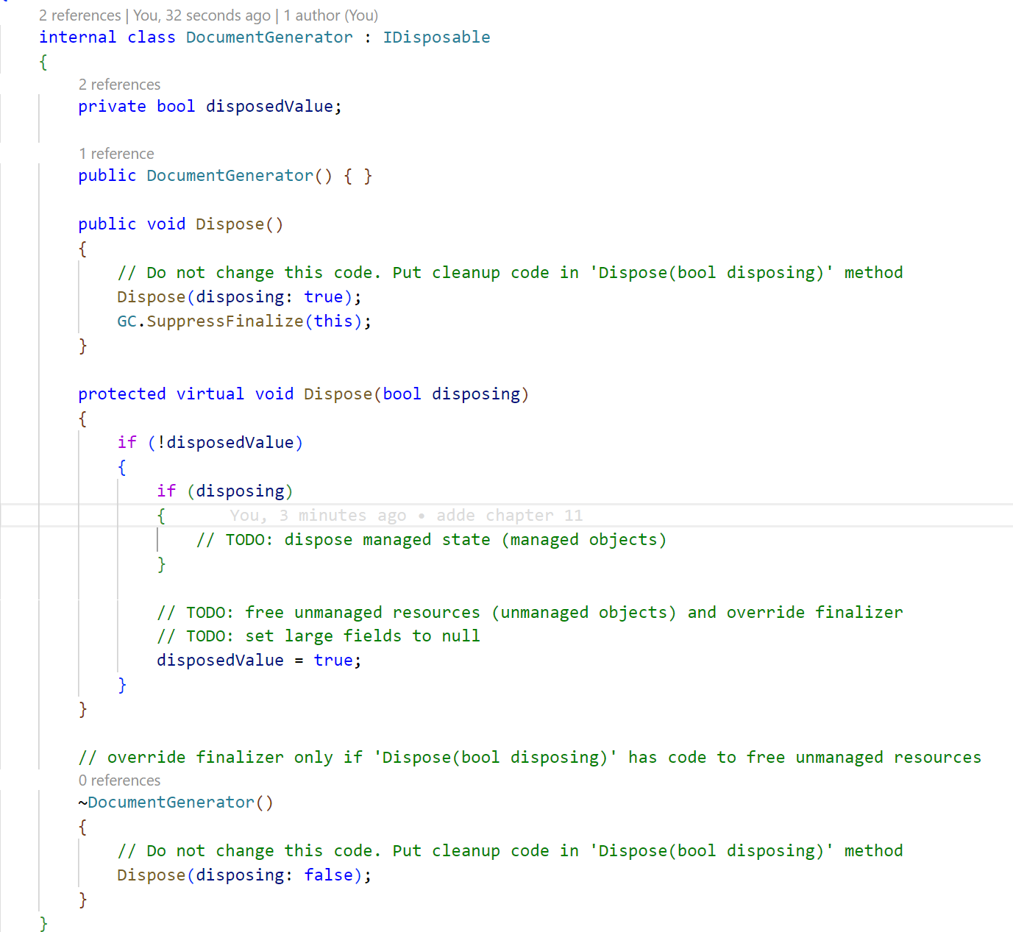
Not virtual
Prevent GC from calling finalizer
Virtual to allow override in child classes
disposing parameter tells if method is called from GC or code

Slide 9
Disposable resource and the « using » keyword
When you unmanaged resource like "Stream" you need to use the "using" keyword that will "Dispose" de resource when you have finish with it.
The "using" keyword means that you are going to use this resource to perform some operation like writing a file and then when you have finish with this resource, it will be disposed automatically.
More about the using statement or Pattern based using and using declarations
public void GenerateContract(Employee employee, string directory)
{
string fileName = $"{employee.Name}-{employee.FirstName}.txt";
using (FileStream fs = File.Create($"{directory}/{fileName}"))
{
string dataasstring = $"Hello, {employee.Name} {employee.FirstName}, this file is your new contract !";
byte[] info = new UTF8Encoding(true).GetBytes(dataasstring);
fs.Write(info, 0, info.Length);
byte[] data = new byte[] { 0x0 };
fs.Write(data, 0, data.Length);
}
}

Slide 10
Guidelines
DO | Use using to dispose resources used during a method
DO | Implement the correct Dispose pattern on types containing instances of disposable types
DO | Throw an ObjectDisposedException from any member that cannot be used after the object has been disposed of.
DO | Call GC.SuppressFinalizer(this) in the dispose implementation and call Dispose(false) in the class finalizer.
DON’T | Make the parameterless Dispose method virtual
DON’T | Declare any overloads of the Dispose method other than Dispose() and Dispose(bool)
DON’T | Throw exceptions from within Dispose(bool) except under critical situations where the containing process has been corrupted

